Slide 1
Introduction to SQL
PHP & MySQL for Dynamic Web Sites

Slide 2
What You Will Learn
Creating Databases and Tables
Inserting Records
Selecting Data
Using Conditionals
Using LIKE and NOT LIKE
Sorting Query Results
Limiting Query Results
Updating Data
Deleting Data
Using Functions

Slide 3
What is SQL
SQL is a standard language for storing, manipulating and retrieving data in databases.

Slide 4
Creating Databases and Tables
To Create Database
Syntax:
CREATE DATABASE databasename;
Example:
CREATE DATABASE sitename;

Slide 5
Creating Databases and Tables
To Create Table
Syntax:
CREATE TABLE table_name (
column1name description,
column2name description,
);
Example:
CREATE TABLE users (
id int(11) UNSIGNED NOT NULL AUTO_INCREMENT,
name VARCHAR(255),
name VARCHAR(255),
created_on DATETIME,
PRIMARY KEY (id)
);

Slide 6
Inserting Records
Syntax
INSERT INTO table_name (column1, column2, column3, ...) VALUES (value1, value2, value3, ...);
Example
INSERT INTO users (name, email, created_on) VALUES (‘Effy’,’effy@skins.co.uk’, Now());

Slide 7
Selecting Data
Syntax:
SELECT columns FROM table_name;
Example;
SELECT name, email FROM users;
SELECT * FROM users;

Slide 8
Using Conditionals
Syntax:
SELECT columns FROM table_name WHERE conditions
Example:
SELECT * FROM users WHERE id=1;

Slide 9
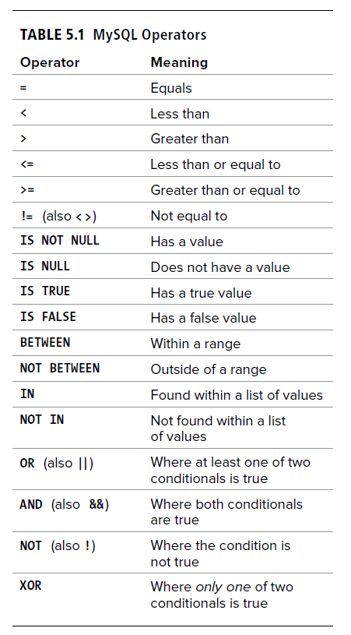
MySQL Operators

Slide 10
Using Conditionals: AND, OR, NOT
Syntax:
AND
SELECT columns FROM table_name WHERE condition1 AND condition2 AND condition3 ...;
OR
SELECT columns FROM table_name WHERE condition1 OR condition2 OR condition3 ...;
NOT
SELECT columns FROM table_name WHERE NOT condition1;
Example:
SELECT * FROM users WHERE id=1 AND name=’Effy’;
SELECT * FROM users WHERE id=2 OR name=’Effy’;
SELECT * FROM users WHERE NOT id=2 ;

Slide 11
Using Conditions: BETWEEN
Syntax
SELECT column_name(s)
FROM table_name
WHERE column_name BETWEEN value1 AND value2;
Example:
SELECT * FROM users
WHERE age BETWEEN 10 AND 20;

Slide 12
Using Conditionals: Date Ranges
Example:
SELECT * FROM table WHERE date_column >= '2014-01-01' AND date_column <= '2015-01-01';
Alternatively,
SELECT * FROM table WHERE date_column BETWEEN '2014-01-10' AND '2015-01-01';

Slide 13
Using Conditions: IS NULL
Syntax
SELECT column_name(s)
FROM table_name
WHERE column_name IS NULL;
Example:
SELECT * FROM users
WHERE email IS NULL;

Slide 14
Using LIKE and NOT LIKE
Syntax (LIKE)
SELECT column1, column2, ...
FROM table_name
WHERE column LIKE pattern;
Syntax (NOT LIKE)
SELECT column1, column2, ...
FROM table_name
WHERE column NOT LIKE pattern;
Example;
SELECT * FROM users
WHERE name LIKE ‘E%’’
(every name starts with E)
SELECT * FROM users
WHERE name NOT LIKE ‘E%’’
(every name starts without E)

Slide 15
WildCards
Effy, Emily, Katie, Pandora, Naomi
Finds any values that start with "E" | ‘E%’ | Effy, Emily
Finds any values that end with "y" | ‘%y’ | Effy, Emily
Finds any values that have "ff" in any position | ‘%ff%’ | Effy
Finds any values that have "a" in the second position | ‘_a%’ | Katie, Pandora, Naomi
Finds any values that starts with "E" and are at least 5 characters in length | ‘E_%_%_%_%’ | Emily

Slide 16
Other WildCards
hot, hat, hit
any single character within the brackets | ‘h[oa]t’ | hot, hat
a range of characters | ‘h[a-i]t’ | hat, hit
any character not in the brackets | ‘h[^oa]t’ | hit

Slide 17
Sorting Query Results
SELECT column1, column2, ...
FROM table_name
ORDER BY column1, column2, ... ASC;
SELECT column1, column2, ...
FROM table_name
ORDER BY column1, column2, ... DESC;
SELECT * FROM users ORDER BY name ASC;
SELECT * FROM users ORDER BY name DESC;
SELECT * FROM users ORDER BY lastname ASC, firstname ASC; (sort lastname first then firstname)

Slide 18
Limiting Query Result
Syntax
SELECT * FROM tablename LIMIT x
SELECT * FROM tablename LIMIT x, y
Example
SELECT * FROM users LIMIT 10;
(will show only 10 records)
SELECT * FROM users LIMIT 10,10;
(will show record from 11 to 20)

Slide 19
Updating Data
Syntax
UPDATE table_name
SET column1 = value1, column2 = value2, ...
WHERE condition;
Example
UPDATE users
SET name = 'Katie', City= 'katie@skins.co.uk'
WHERE id = 1;

Slide 20
Deleting Data
Syntax
DELETE FROM table_name
WHERE condition;
Example
DELETE FROM users
WHERE id = 1;

Slide 21
Alias
Column Syntax
SELECT column_name AS alias_name FROM table_name;
Table Syntax
SELECT column_name FROM table_name AS alias_name;
Example
SELECT name AS fullname FROM users;
SELECT u.name FROM users AS u;

Slide 22
Using Functions
Concat ()
SELECT CONCAT(first_name, ‘ ‘ , last_name) AS full_name FROM users;

Slide 23
Using Functions
Format ()
SELECT FORMAT(250500.5634, 2);
//output: 250,500.56

Slide 24
Using Functions
DATE ()
SELECT DATE("2017-06-15 09:34:21")
//output: 2017-06-15
SELECT DATE(created_on) AS Date FROM users

Slide 25
Using Functions
DATEDIFF ()
SELECT DATEDIFF("2017-06-25", "2017-06-15");
//output: 10
SELECT DATEDIFF(now(), created_on) FROM posts;
// Output: 1

Slide 26
Using Functions
DATE_FORMAT ()
SELECT DATE_FORMAT("2021-01-25 00;00:00:00", "%Y %M %D");
//Output 2021 January 25

Slide 27
Using Functions
DAYNAME ()
SELECT DATENAME("2021-01-25 00;00:00:00");
//Output Monday

Slide 28
Using Functions
COUNT ()
SELECT COUNT(id) AS total FROM products;
//Output 77

Slide 29
END
ANY QUESTION?

